Slide 1
Chapter 13: Data Transmission

Slide 2
Objectives
After studying this chapter, students should be able to:
Describe various types of data transmission media and methods.
Explain transmission modes and techniques for digital signal modulation.
Define and differentiate multiplexing and demultiplexing.
Discuss types of buses, their characteristics, and communication protocols.
Explain multiplexed buses and tri-state outputs.
Present common bus standards such as PCI, USB, RS-232, SPI, I²C, CAN, SCSI, etc.

Slide 3
Contents
13.1. Data Transmission Media 13.2. Methods and Modes of Data Transmission 13.3. Modulation of Analog Signals with Digital Data 13.4. Modulation of Digital Signals with Analog Data 13.5. Multiplexing and Demultiplexing 13.6. Bus Basics 13.7. Parallel Buses 13.8. The Universal Serial Bus (USB) 13.9. Other Serial Buses 13.10. Bus Interfacing

Slide 4
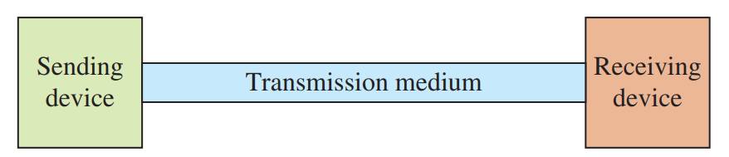
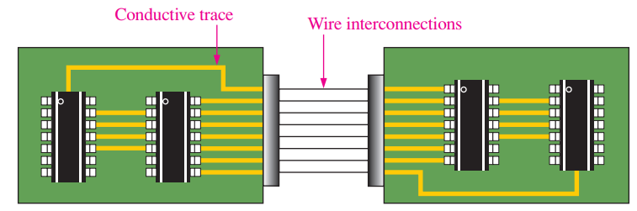
13.1. Data Transmission Media
Wire Connections

Slide 5
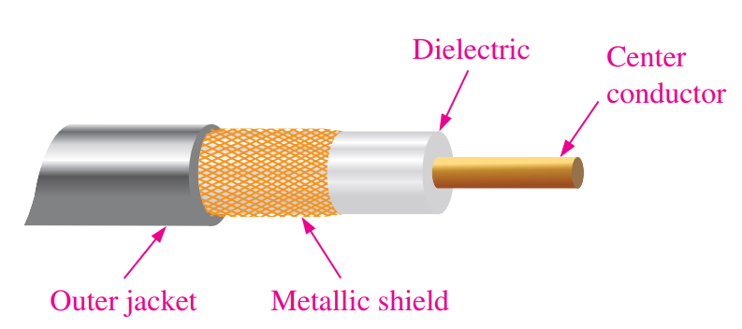
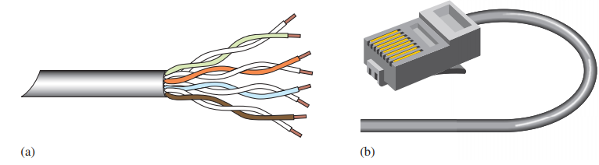
13.1. Data Transmission Media
Coaxial Cable
Twisted Pair Cable

Slide 6
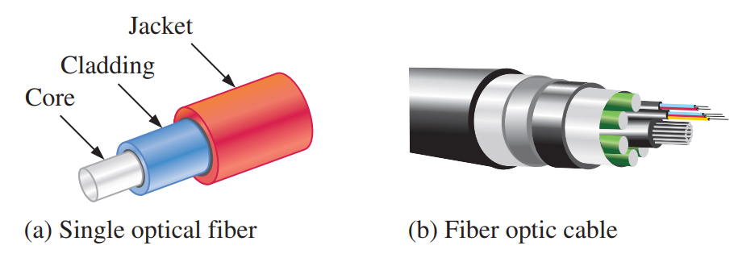
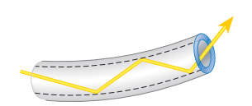
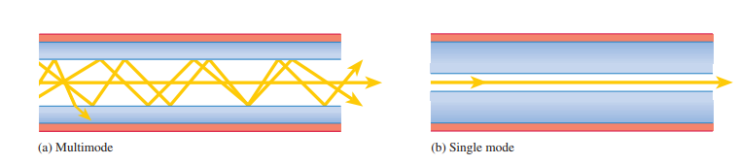
13.1. Data Transmission Media
Optical Fiber Cable
FIGURE 13–6 Light propagating through an optical fiber while reflecting off the internal surface.

Slide 7
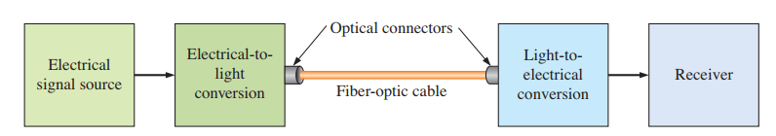
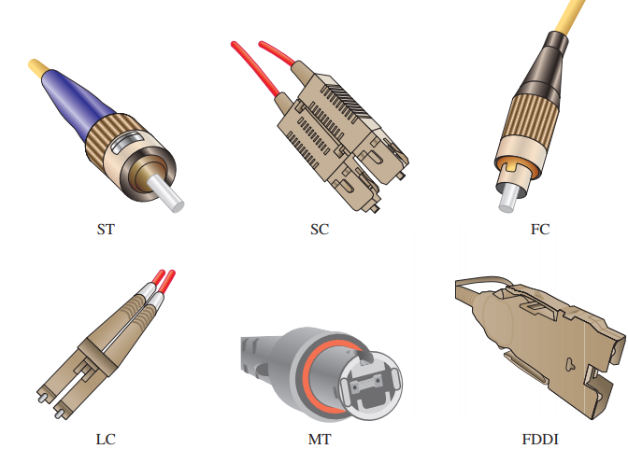
13.1. Data Transmission Media
A Fiber-Optic Data Communications Link

Slide 8
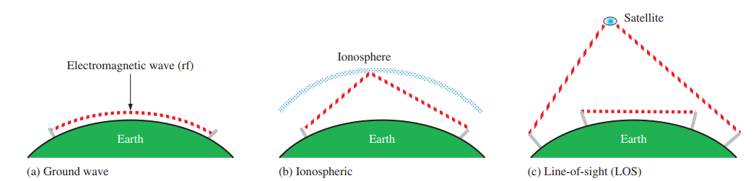
13.1. Data Transmission Media
Wireless Transmission Radio and microwave signals propagate through the atmosphere in three main ways: ground wave, ionospheric, and line-of-sight, each with different distance limits and usage depending on frequency, terrain, and transmission method.

Slide 9
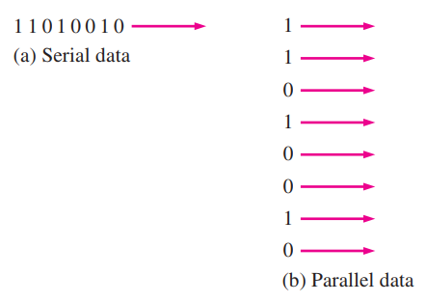
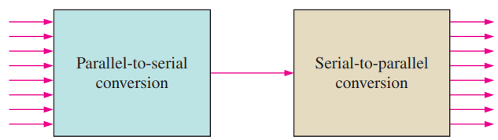
13.2. Methods and Modes of Data Transmission
Serial and Parallel Data Serial data transmission is when data are transmitted one bit at a time in a bit stream Parallel data transmission is when data are transmitted several bits at a time

Slide 10
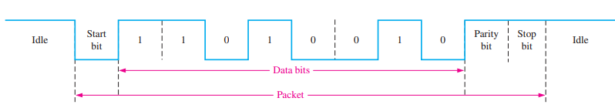
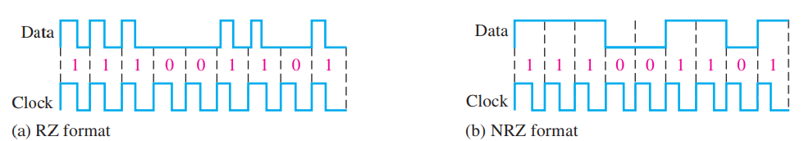
13.2. Methods and Modes of Data Transmission
Asynchronous Data
Synchronous Data

Slide 11
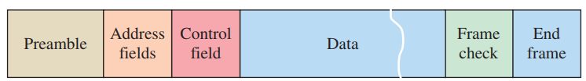
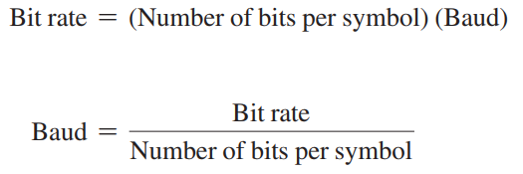

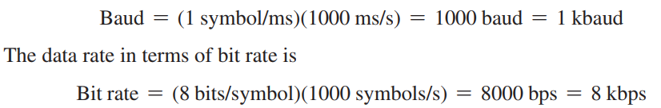
13.2. Methods and Modes of Data Transmission
Synchronous Frames
Data Rate

Slide 12

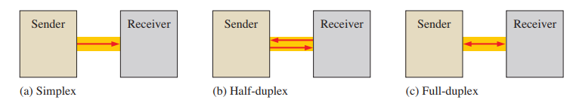

13.2. Methods and Modes of Data Transmission
Transmission Efficiency
Transmission Modes

Slide 13
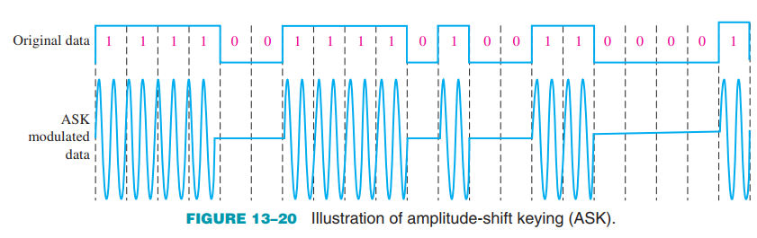
13.3. Modulation of Analog Signals with Digital Data
Amplitude-Shift Keying Amplitude-shift keying (ASK) is a form of modulation in which a digital signal varies the amplitude of a higher frequency sine wave (carrier). In its simplest form, a sinusoidal carrier signal is turned on and off by the data signal and, therefore, this method is also known as on-off keying (OOK).

Slide 14
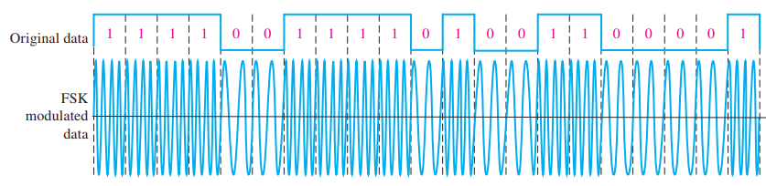
13.3. Modulation of Analog Signals with Digital Data
Frequency-Shift Keying Frequency-shift keying (FSK) is a form of modulation in which a digital signal modulates the frequency of a higher frequency sine wave (carrier). A carrier signal with a lower frequency generally represents a binary 0, and a carrier signal with a higher frequency represents a binary 1.

Slide 15
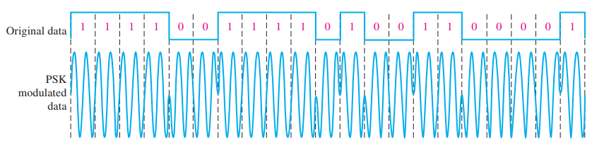
13.3. Modulation of Analog Signals with Digital Data
Phase-Shift Keying Phase-shift keying (PSK) is a form of modulation in which a digital signal modulates the phase of a higher frequency sine wave. A carrier signal of one phase generally represents a binary 1, and a carrier signal that is 180° out-of-phase represents a binary 0.

Slide 16
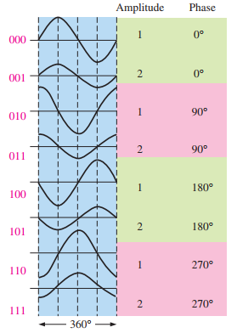
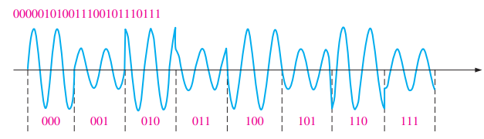

13.3. Modulation of Analog Signals with Digital Data
Quadrature Amplitude Modulation

Slide 17
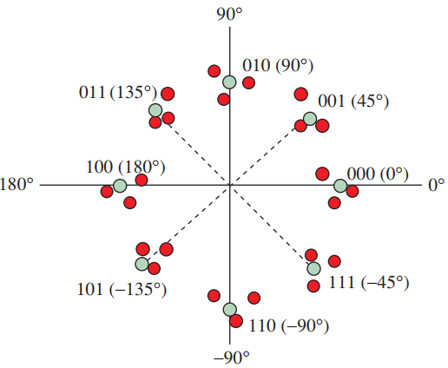
13.3. Modulation of Analog Signals with Digital Data
Constellation Maps
Modulated transmission of digital data can be represented by a constellation map, which is a vector representation that graphically shows the symbol values and corresponding phases being transmitted by a system

Slide 18
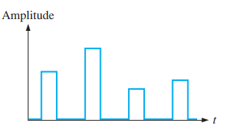

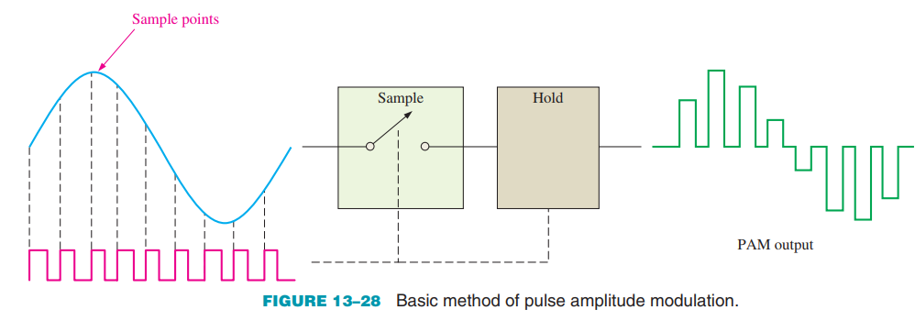
13.4. Modulation of Digital Signals with Analog Data
Pulse Amplitude Modulation

Slide 19
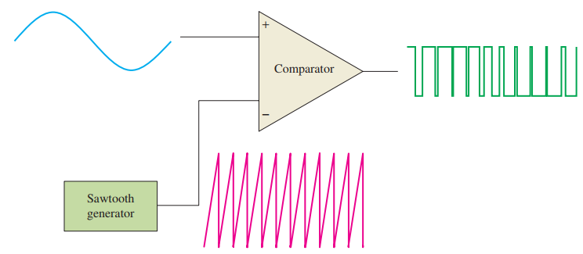
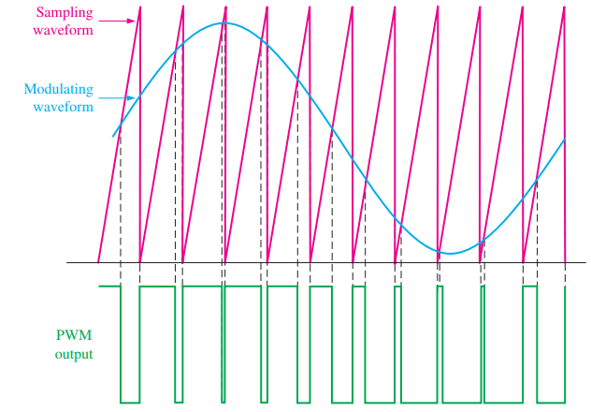
13.4. Modulation of Digital Signals with Analog Data
Pulse Width Modulation

Slide 20
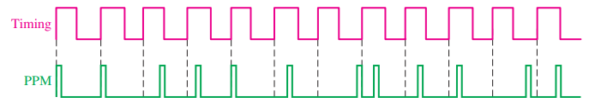
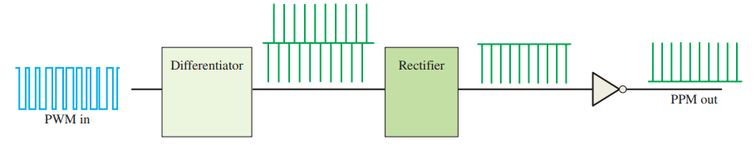
13.4. Modulation of Digital Signals with Analog Data
Pulse Position Modulation

Slide 21
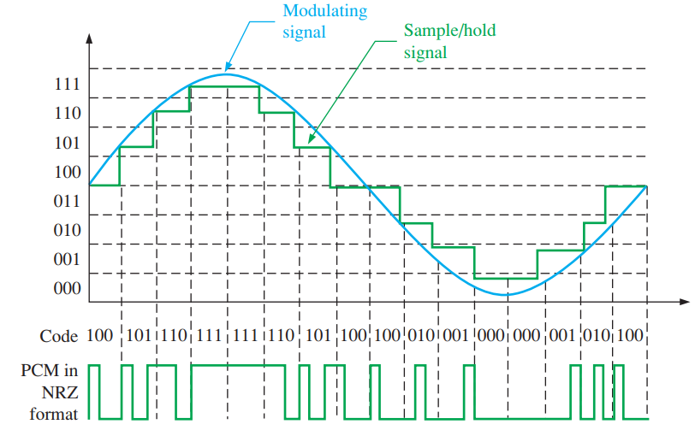
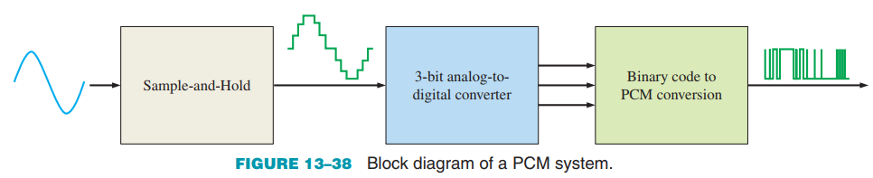
13.4. Modulation of Digital Signals with Analog Data
Pulse Code Modulation

Slide 22
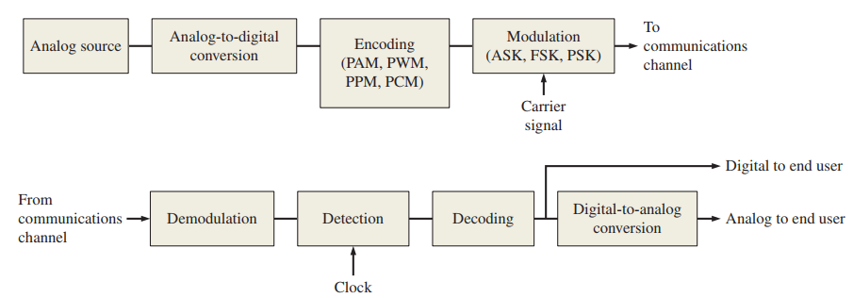
13.4. Modulation of Digital Signals with Analog Data
Digital Data Systems

Slide 23
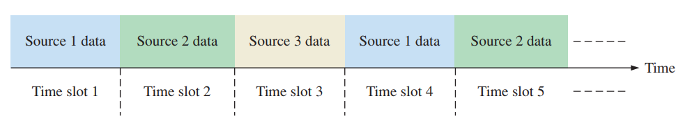
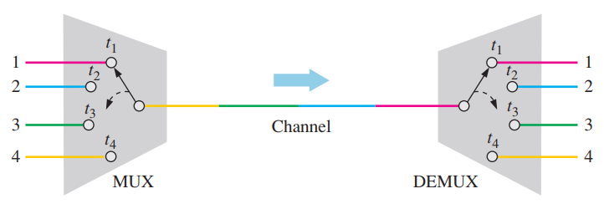
13.5. Multiplexing and Demultiplexing
Time-Division Multiplexing

Slide 24
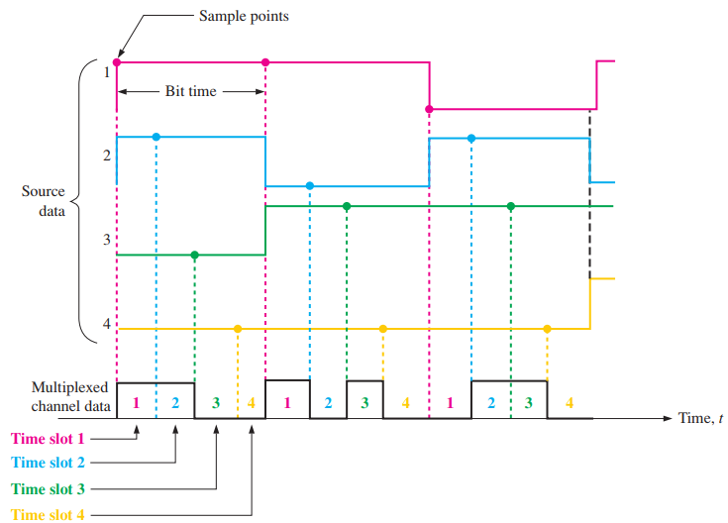
13.5. Multiplexing and Demultiplexing
Bit-Interleaved TDM

Slide 25
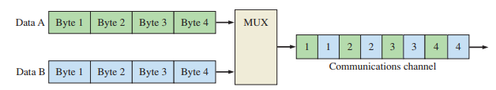
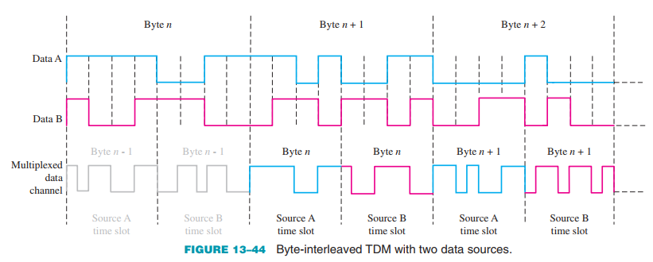
13.5. Multiplexing and Demultiplexing
Byte-Interleaved TDM

Slide 26
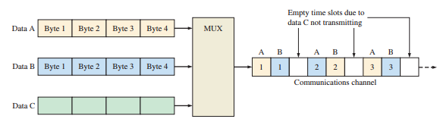
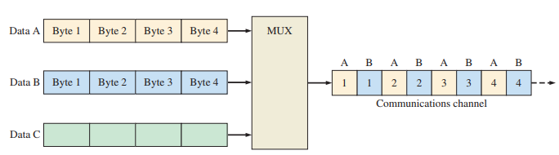
13.5. Multiplexing and Demultiplexing
Synchronous TDM
Statistical TDM

Slide 27
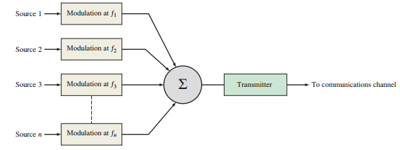
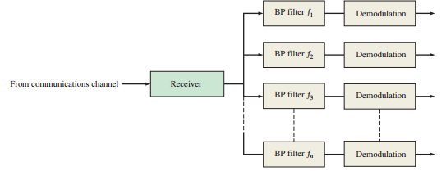
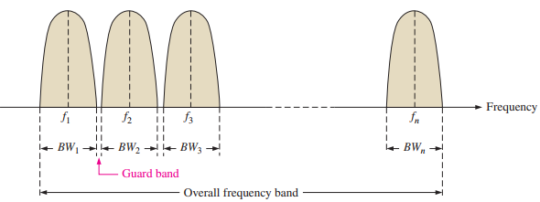
13.5. Multiplexing and Demultiplexing
Frequency-Division Multiplexing

Slide 28
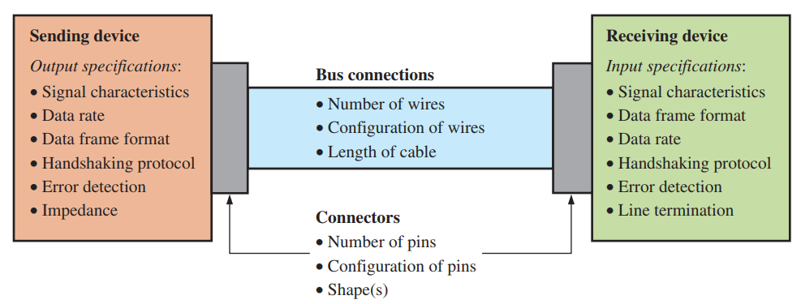
13.6. Bus Basics
The Bus A bus allows two or more devices to communicate with each other, generally to transmit data.

Slide 29
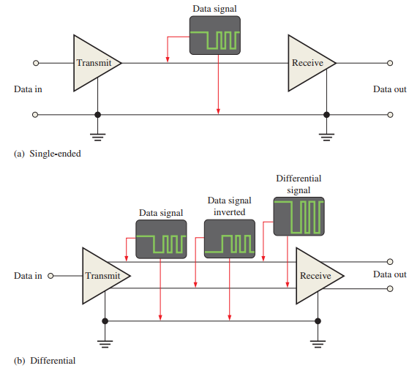
13.6. Bus Basics
Single-Ended vs. Differential Buses

Slide 30
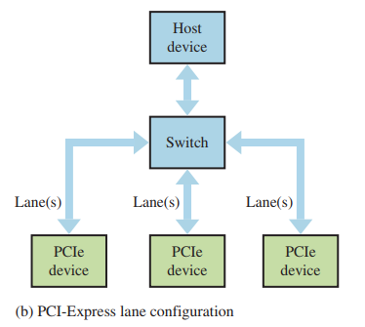
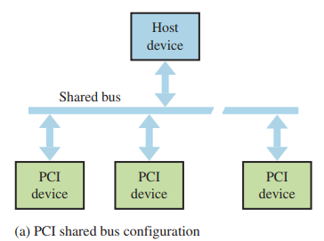
13.7. Parallel Buses
The PCI-Express Bus

Slide 31

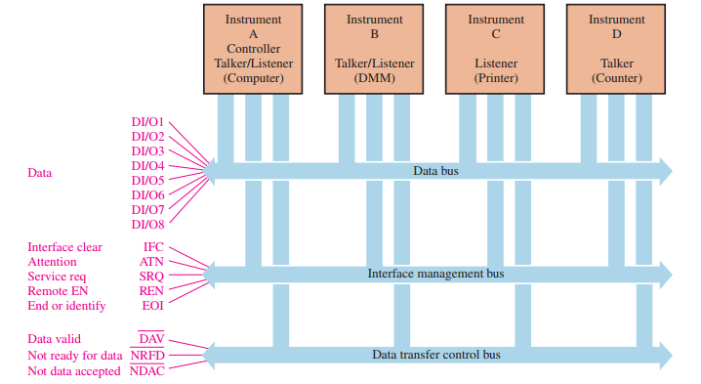

13.7. Parallel Buses
The IEEE-488 Bus

Slide 32
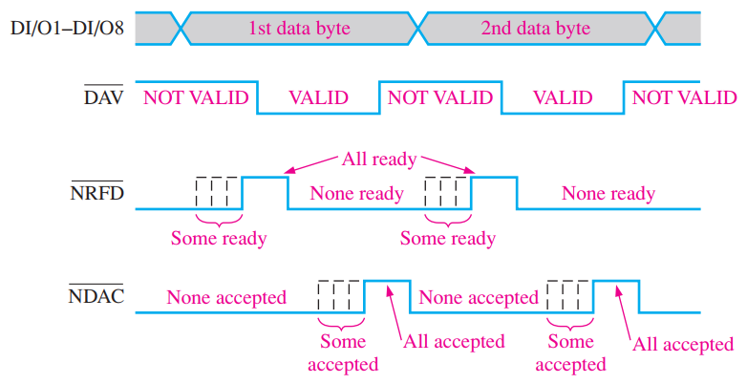
13.7. Parallel Buses
The IEEE-488 Bus
Timing diagram

Slide 33
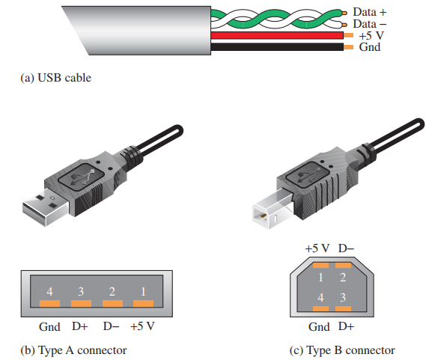

13.8. The Universal Serial Bus (USB)
USB Cable and Connectors

Slide 34


13.8. The Universal Serial Bus (USB)
USB 3.0

Slide 35




13.9. Other Serial Buses
The RS-232/422/423/485 Buses RS-232 Bus

Slide 36

13.9. Other Serial Buses
The RS-232/422/423/485 Buses RS-422/423/485 The RS-422 bus provides for differential transmission for greater distances (longer cable length) and has higher data rates than the RS-232 bus.

Slide 37

13.9. Other Serial Buses
The SPI Bus The SPI bus is typically used in embedded systems and on PCBs for communication between microprocessors or microcontrollers and peripheral IC chips or between two processors.

Slide 38

13.9. Other Serial Buses
The I2C Bus I2C bus (pronounced I squared C) is also stated at I2C (I two C) and stands for inter-integrated circuit. It is an internal serial bus primarily for connecting ICs on a PCB.

Slide 39


13.9. Other Serial Buses
The CAN Bus

Slide 40

13.9. Other Serial Buses
The Firewire Bus

Slide 41

13.10. Bus Interfacing
Basic Multiplexed Buses

Slide 42


13.10. Bus Interfacing
Connecting Devices to a Bus

Slide 43
SUMMARY
Chapter 13: Data Transmission
A data transmission system consists of three main components: the sending device, transmission medium, and receiving device.
Data can be transmitted through physical connections such as coaxial cables, twisted pairs, optical fibers, or wirelessly through the air.
There are three RF/microwave propagation methods: ground wave, ionospheric reflection, and line-of-sight transmission.
Two main data transmission types are synchronous and asynchronous, and data can be encoded using RZ/NRZ or Manchester encoding.
Multiplexing allows multiple digital data streams to be transmitted over a single communication channel; demultiplexing separates them.
A bus has physical and electrical properties such as number of conductors, configuration, voltage levels, clock signals, bandwidth, data format, etc.
Common bus types include parallel buses (e.g., PCI, AGP) and serial buses (e.g., USB, RS-232, SPI, I²C), operating in either synchronous or asynchronous modes.

Slide 44
MULTIPLE-CHOICE TEST AND PROBLEMS
Complete the true/false questions, multiple-choice questions, and end-of-chapter exercises in the primary textbook.

